Slide 1
電腦視覺與深度學習 (Computer Vision and Deep Learning) Homework 1
TA:胡滋紜
Gmail: nckubot65904@gmail.com
Office Hour: 14:00~16:00, Mon.
10:00~12:00, Fri.
At CSIE 9F Robotics Lab.

Slide 2
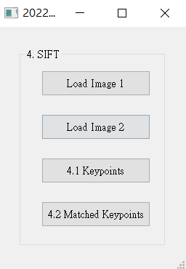
4. (20%) SIFT
(出題：Chen)
4.1 (10%) Keypoints
4.2 (10%) Matched Keypoints

Slide 3
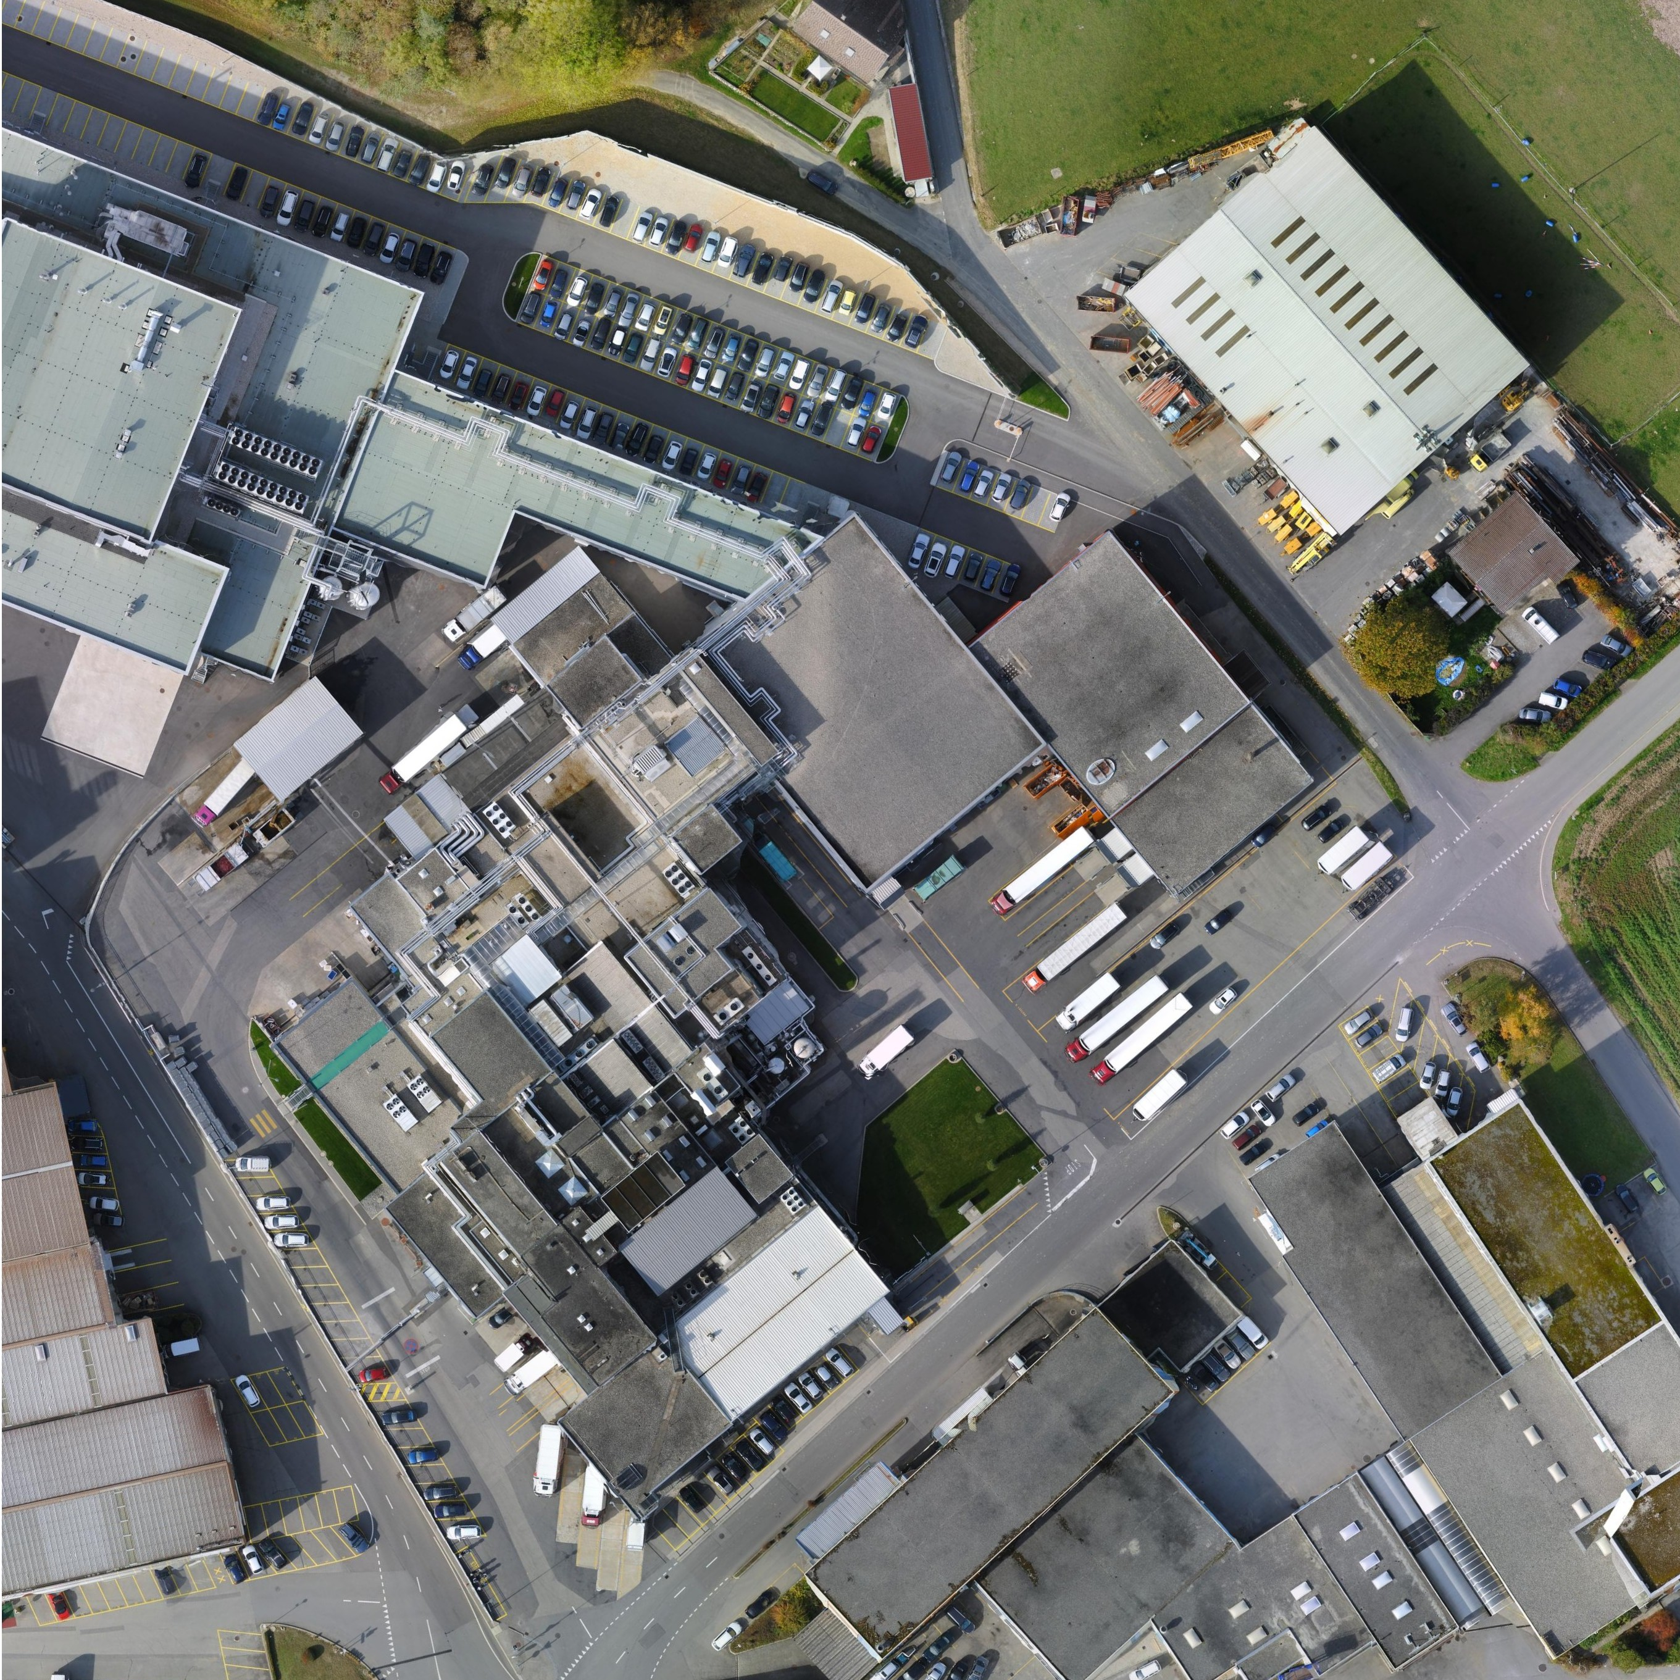
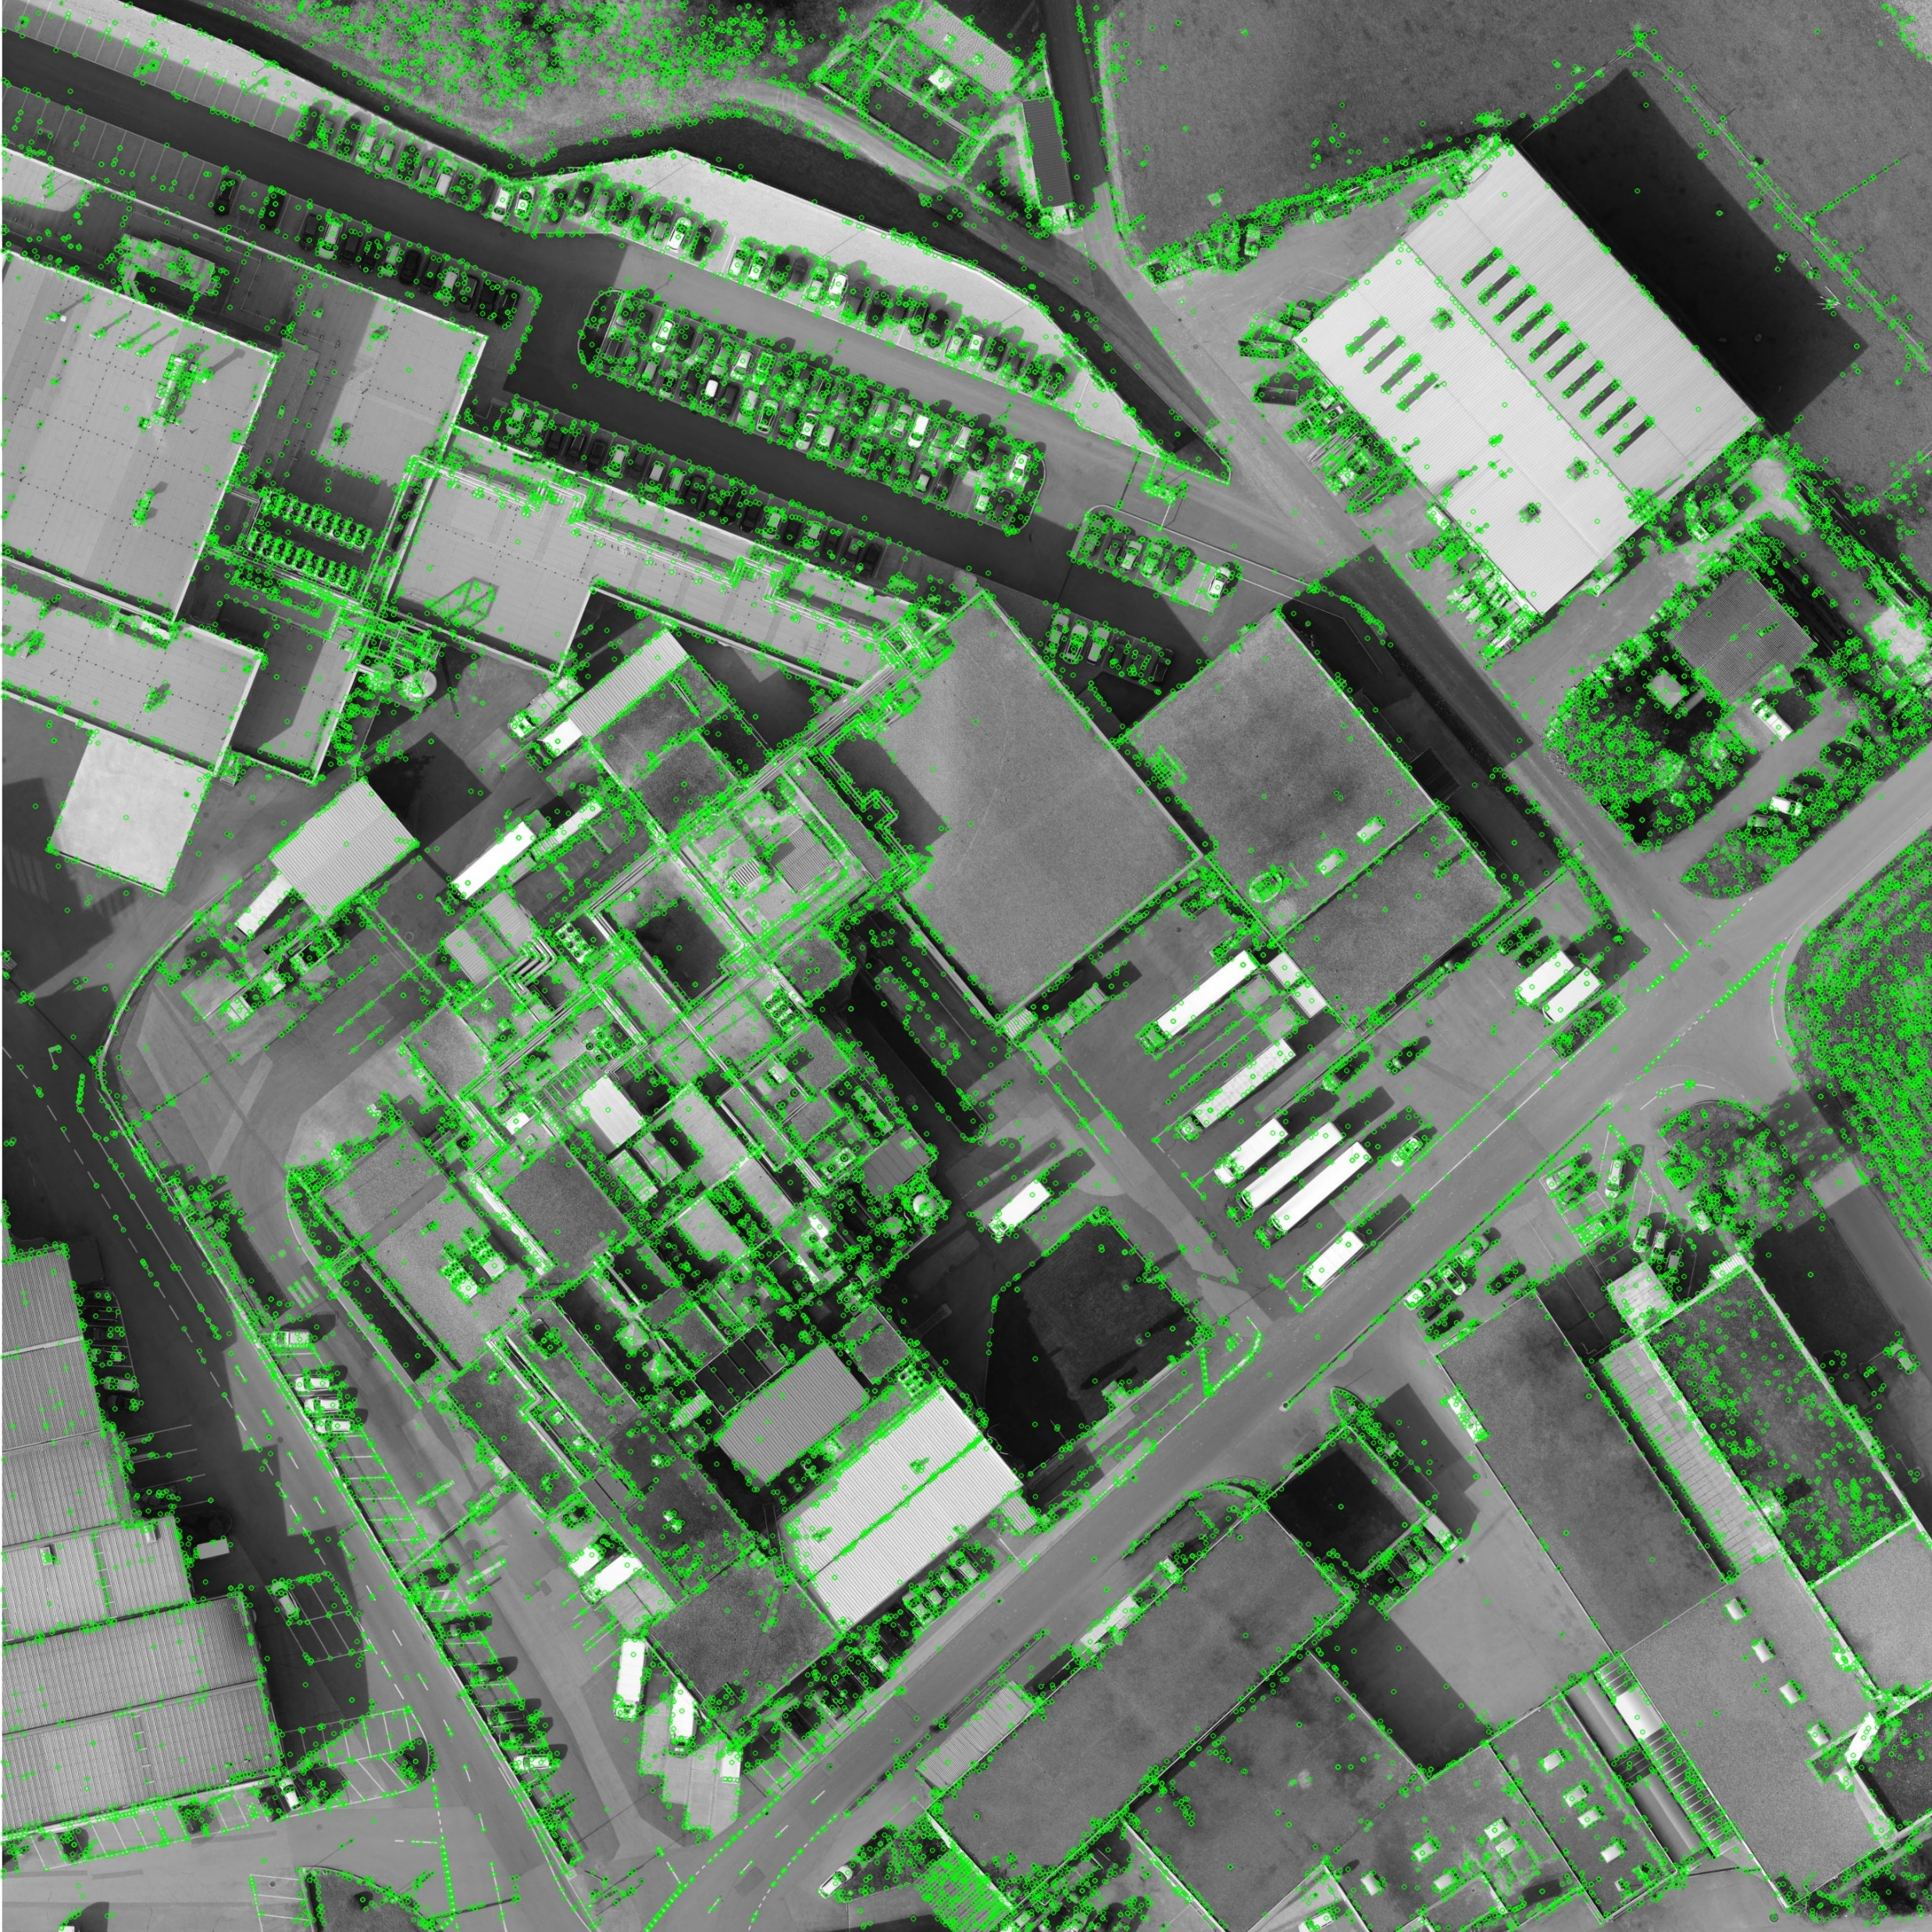
4.1 (10%) Keypoints
(出題：Chen)
Click button “4.1 Keypoints” to show:
Load Left.jpg (click “Load Image 1”)
Based on SIFT algorithm, find key points on Left.jpg.
Hint: Use OpenCV SIFT detector to detect keypoints and descriptors.
sift = cv.SIFT_create() # Create a SIFT detector
sift.detectAndCompute(image,None)
Then draw the keypoints of Left.jpg as I₁.
Hint: cv.drawKeypoints(gray,kp,None,color=(0,255,0))
Please show image I₁
Input:
Output:
Left.jpg
I₁
Reference : OpenCV Textbook SIFT, p321, 464, 524

Slide 4
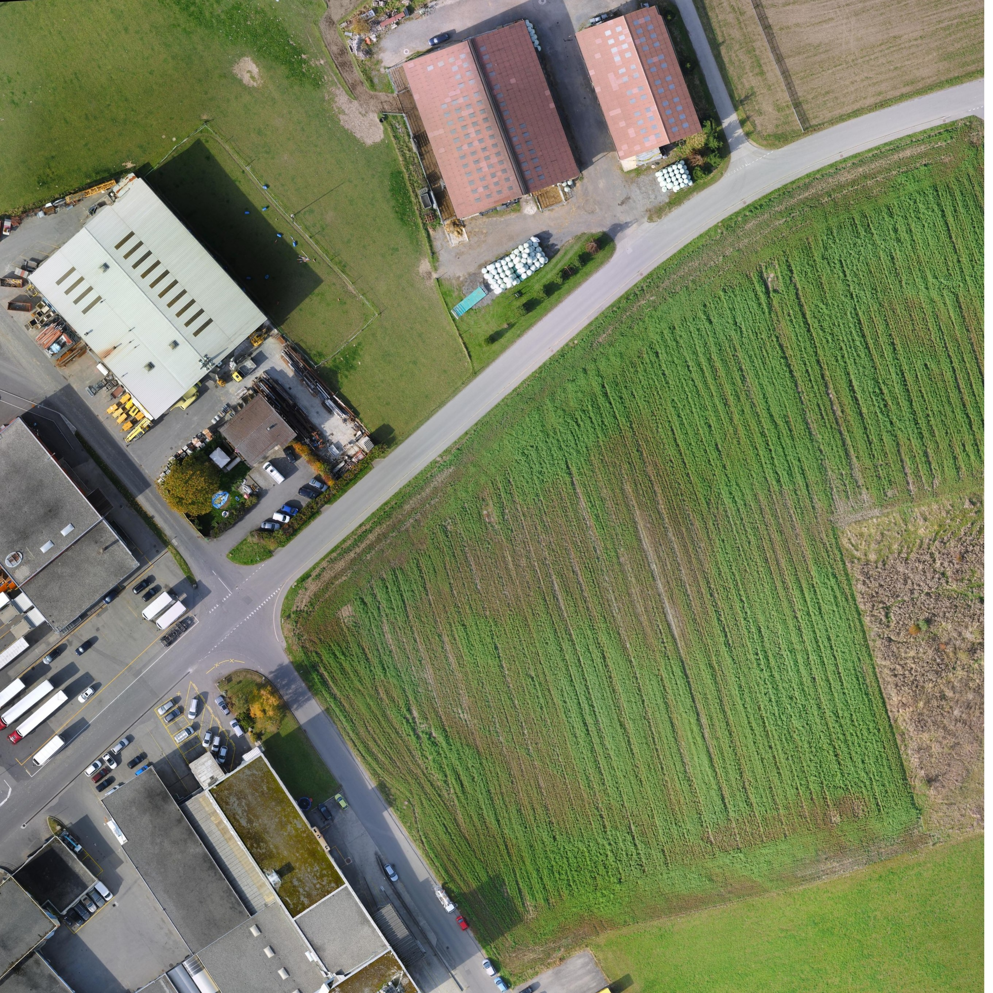
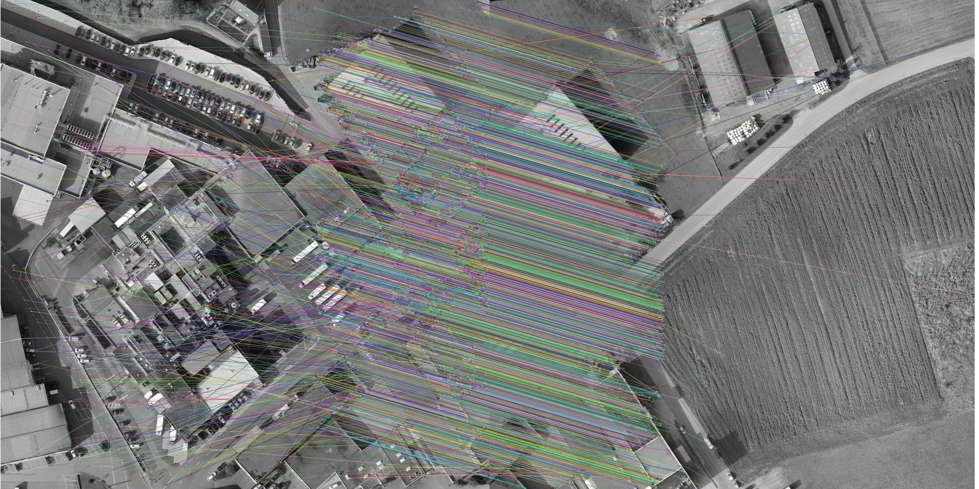
4.2 (10%) Matched Keypoints
(出題：Chen)
Click button “4.2 Matched Keypoints”,
Load Image 1 (Left.jpg) and Image 2 (Right.jpg)
Based on SIFT algorithm, find the keypoints and descriptors at Image 1 and Image 2 (same as question 1)
Find match keypoint of two images
Hint: Use BFMatcher.knnMatch(descriptors 1, descriptors 2,k=2) to locate the matched keypoints.
Extract Good Matches from 3) result:
Hint:
Draw the matched feature points between two image
Hint:. Use “cv2.drawMatchesKnn()” to draw the matches,
for m,n in matches:
if m.distance < 0.75*n.distance:
good.append([m])
cv.drawMatchesKnn(img1,kp1,img2,kp2,mat,good,flags=cv.DrawMatchesFlags_NOT_DRAW_SINGLE_POINTS)
Input:
Output:
Please show image I₂
Left.jpg
Right.jpg
I₂
Reference: OpenCV Textbook SIFT, p321, 464, 524

Slide 5
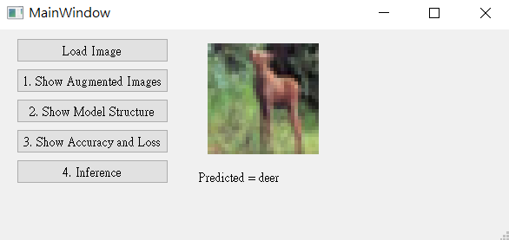
5. Training a CIFAR10 Classifier Using VGG19 with BN (20%)
(出題：Hsiang)
5.1 Load CIFAR10 and show 9 Augmented Images with Labels. (4%)
5.2 Load Model and Show Model Structure. (4%)
5.3 Show Training/Validating Accuracy and Loss. (6%)
5.4 Use the Model with Highest Validation Accuracy to Run Inference, Show the Predicted Distribution and Class Label. (6%)
Figure: GUI example

Slide 6
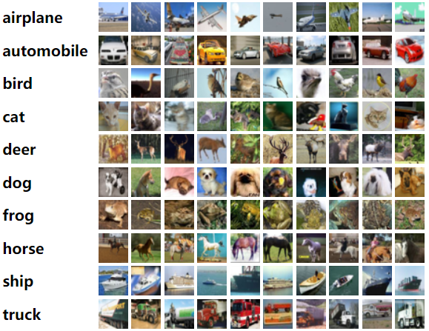
5. Training a CIFAR10 Classifier Using VGG19 with BN (20%)
Objective
Learn how to train a VGG19 with BN (Batch Normalization) model to classify 10 different classes images of CIFAR10.
VGG19 with BN
VGG19: A convolutional neural network that is 19 layers deep.
BN (Batch Normalization): used to make training of artificial neural networks faster and more stable.
CIFAR10
A collection of 60,000 32x32 color images in 10 different classes that is commonly used to train machine learning and computer vision algorithms.
10 classes: airplane, automobile, bird, cat, deer, dog, frog, horse, ship, truck
Datasets
Training dataset: 50000 images in total.
Validation dataset: 10000 images in total.
Testing dataset: 10 images in total. (Generating from validation dataset.)
(出題：Hsiang)
Figure1: CIFAR10
R. Reference
VGG19
Batch Normalization

Slide 7
5. Training a CIFAR10 Classifier Using VGG19 with BN (20%)
Requirements
Train VGG model with batch normalization (BN) using PyTorch.
In the submitted file, you need to include
Weight file for VGG19 with BN in .pth format. (File size is approximately 540MB)
Figure of training/validating loss and accuracy in .jpg or .png format.
Code for your GUI program
Code for model training.
Please do not include image data in the submitted file.
Homework Images
There are 2 different folders in ‘Q5_image’.
In the subfolder ‘Q5_image/Q5_1,' there are 9 different images used in Q5-1. When demoing, use the same images.
In the subfolder 'Q5_image/Q5_4,' there are 9 different images used in Q5-4. These images are used for testing your program. When demoing, we will use different images for the demonstration.
(出題：Hsiang)

Slide 8
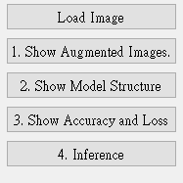
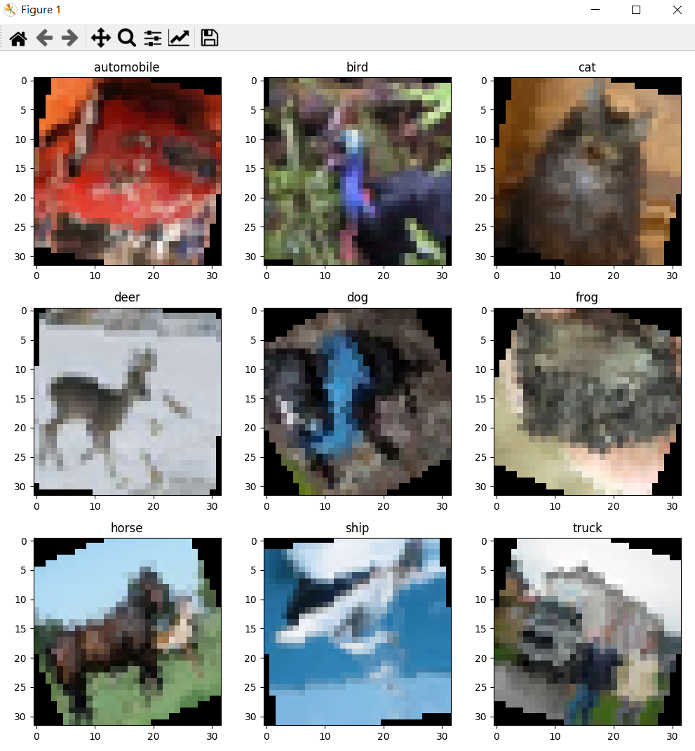
5.1 Show 9 Augmented Images with Labels (3%)
(出題：Hsiang)
Q5.1
At home:
Use PIL.Image.open() to load 9 images in /Q5_image/Q5_1/ folder.
Apply at least 3 different type of data augmentation (tutorial).
transforms.RandomHorizontalFlip()
transforms.RandomVerticalFlip()
transforms.RandomRotation(30)
When the demo:
Click the button “1. Show Augmentation Images”
Load 9 images in /Q5_image/Q5_1/ folder
Apply data augmentation on 9 images.
Show 9 augmented images with label in a new window.
Notice: This is an example; you can use different data augmentation techniques
Figure1: 9 Augmented images Notice: this is an example, the
images might differ

Slide 9
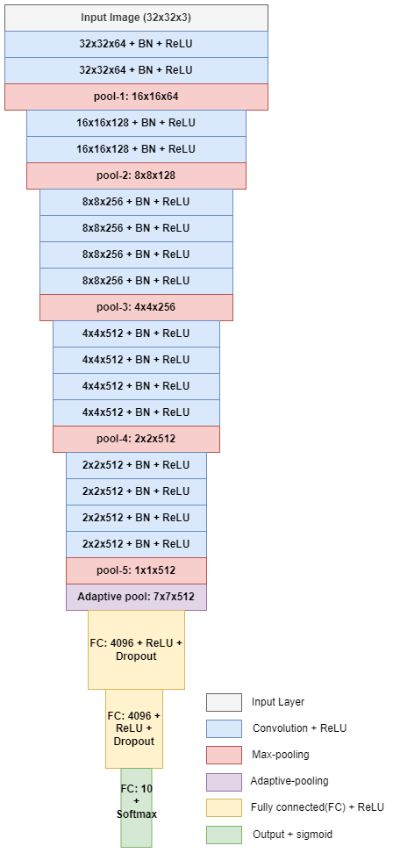
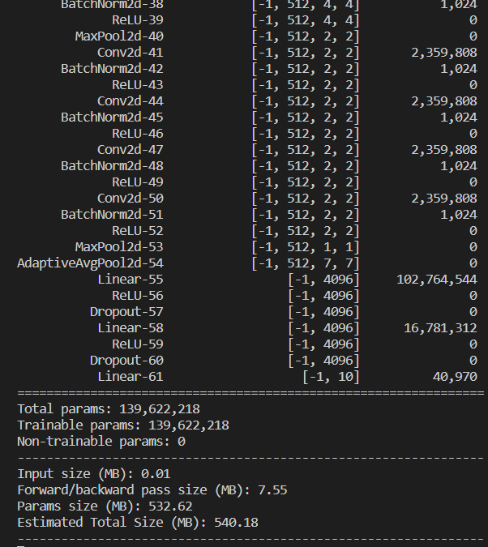
5.2 Show the Structure of VGG19 with BN (3%)
(出題：Hsiang)
Q5.2
At home:
Use torchvision.models.vgg19_bn(num_classes=10) to build a VGG19 with batch normalization (BN) model.
Use torchsummary.summary to show the structure in the terminal.
When the demo:
Click the button “2. Show Model Structure”
Run the function to show the structure in the terminal.
The -1 indicates that the actual size of batch size can vary.
Feature map shape
(Batch, Channels,
Height, Width)
Layer (type)
Num. of param.
All convolution filter size is 3x3
Flatten Here
Figure: the Structure of VGG19 with BN
Figure: VGG19 with BN model structure

Slide 10
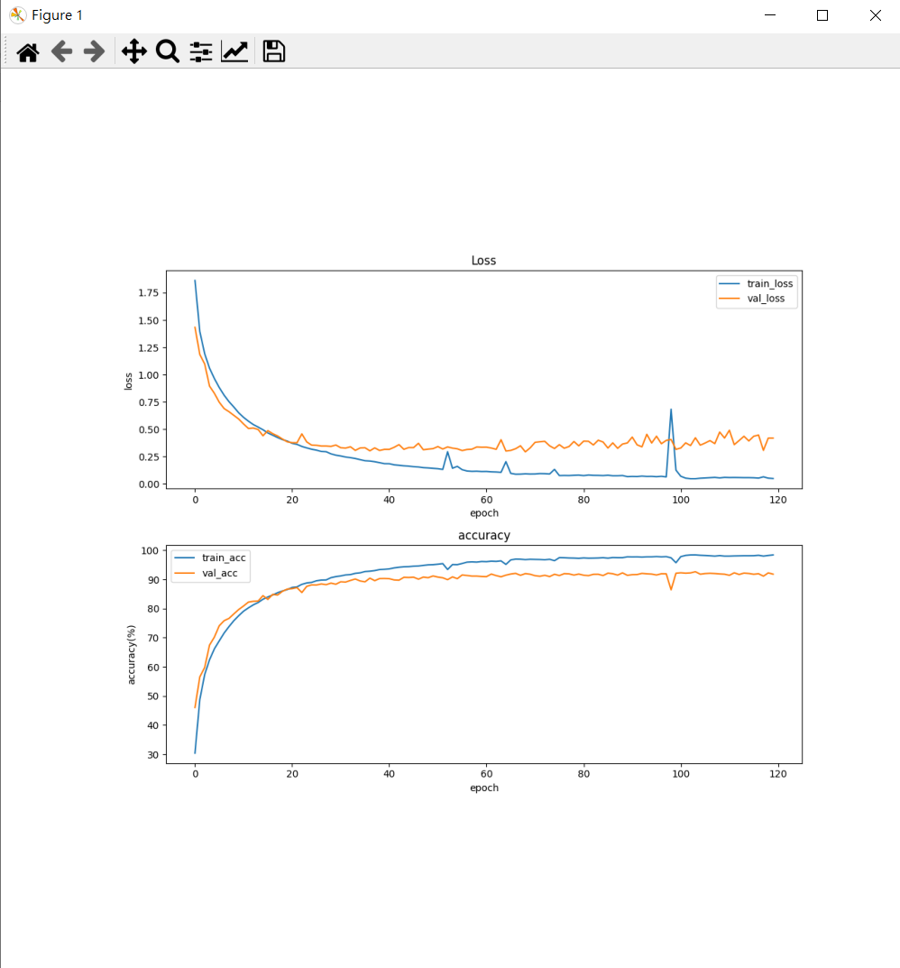
5.3 Show Training/Validating Accuracy and Loss (6%)
(出題：Hsiang)
Q5.3
At home:
Use torchvision.datasets.CIFAR10 to load the training and validation datasets. (tutorial)
Training and validating VGG19 with BN at least 40 epochs at home (tutorial) and record the training/validating accuracy and loss in each epoch (tutorial).
Notice: If your validation accuracy is low, you can try
Adjust the learning rate of the optimizer.
Change the data augmentation techniques used.
Save weight file with highest validation accuracy .
Use matplotlib.pyplot.plot() to create a line chart for the training and validating loss and accuracy values.
Save the figure
When the demo:
Click the button “3. Show Accuracy and Loss”
Show the saved figure of Training/Validating loss and accuracy in a new window
(2) Show the figure in a new window
(1) Click the button.
Notice: this is an example, the number of epoch might differ

Slide 11
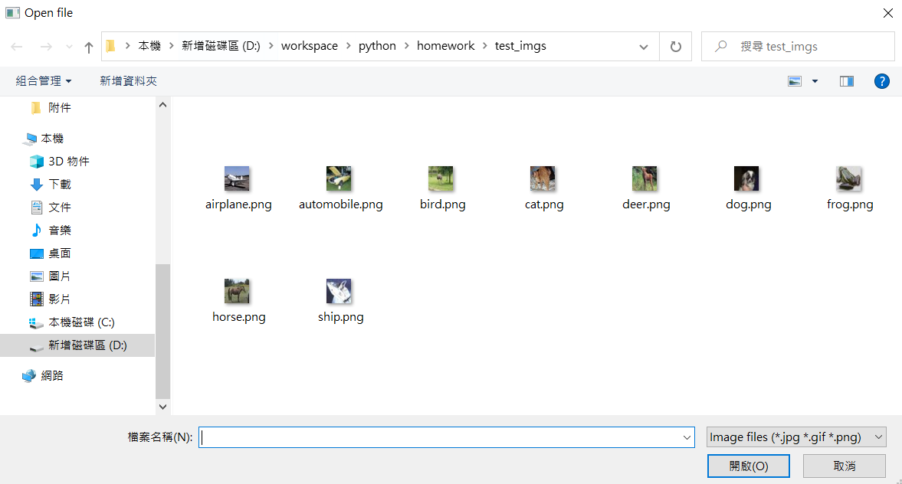
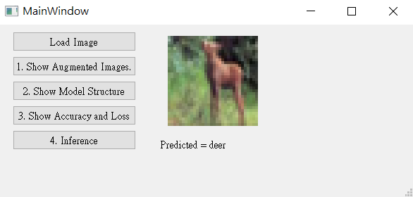
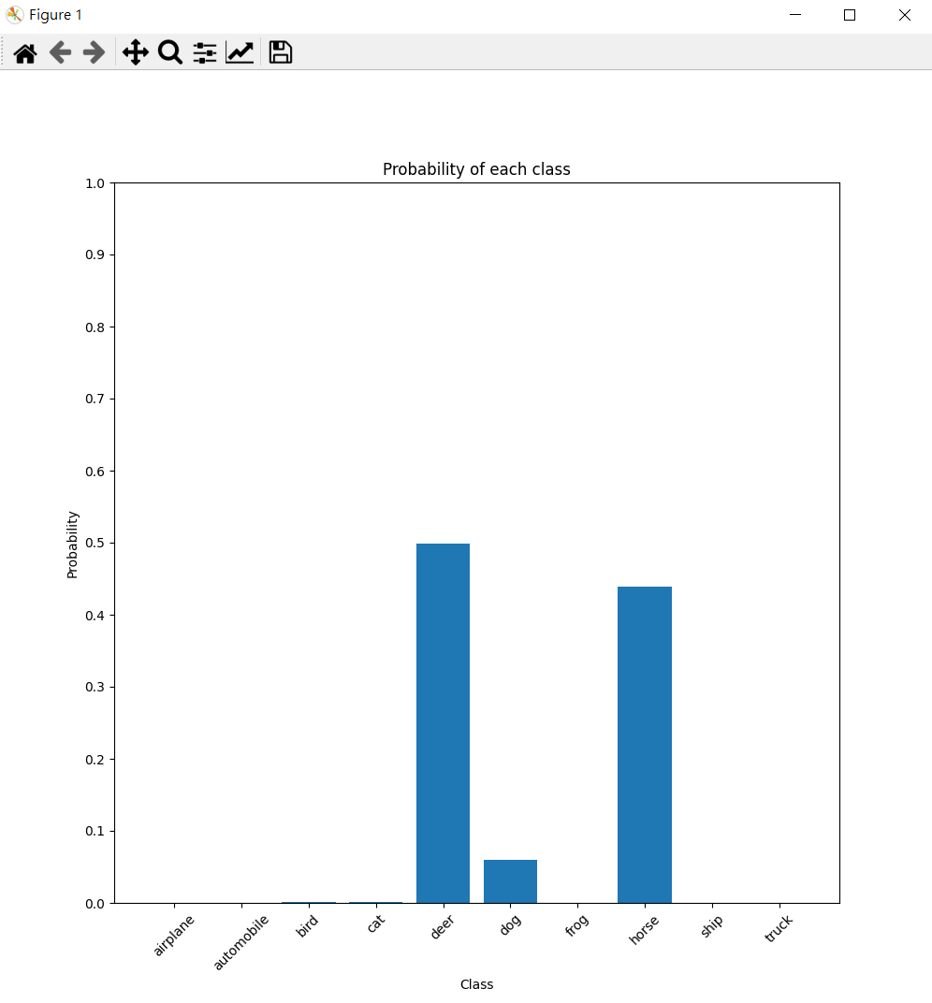
5.4 Use the Model with Highest Validation Accuracy to Run Inference, Show the Predicted Distribution and Class Label. (6%)
(出題：Hsiang)
Q5.4
At home:
Load the model which trained at home
Click the button “Load Image” to display a new file selection dialog
Select 1 image arbitrarily.
Show the loaded image on the GUI. (In order to make it visually clear on the UI, use QtGui.Qpixmap.scaled to scale the image to 128x128 when displaying it.)
Click the button “4. Inference” to run inference on the image. (tutorial)
Show the predicted class label on the GUI.
Show the probability distribution of model predictions using a histogram in a new window.
When the demo: repeat the process
(3) Select 1 image arbitrarily
(2) Click the button.
(4) Show the loaded image (When displaying loaded image, resizing the loaded image to 128x128)
(6) Show the predicted class label
(5) Run inference on the loaded image
(7) Show the probability distribution of model prediction in new window.

Slide 12
5.4 Use the Model with Highest Validation Accuracy to Run Inference, Show the Predicted Distribution and Class Label. (6%)
(出題：Hsiang)
The probability distribution of model prediction using a histogram.
Y-axis: probability
X-axis: class name

Slide 13
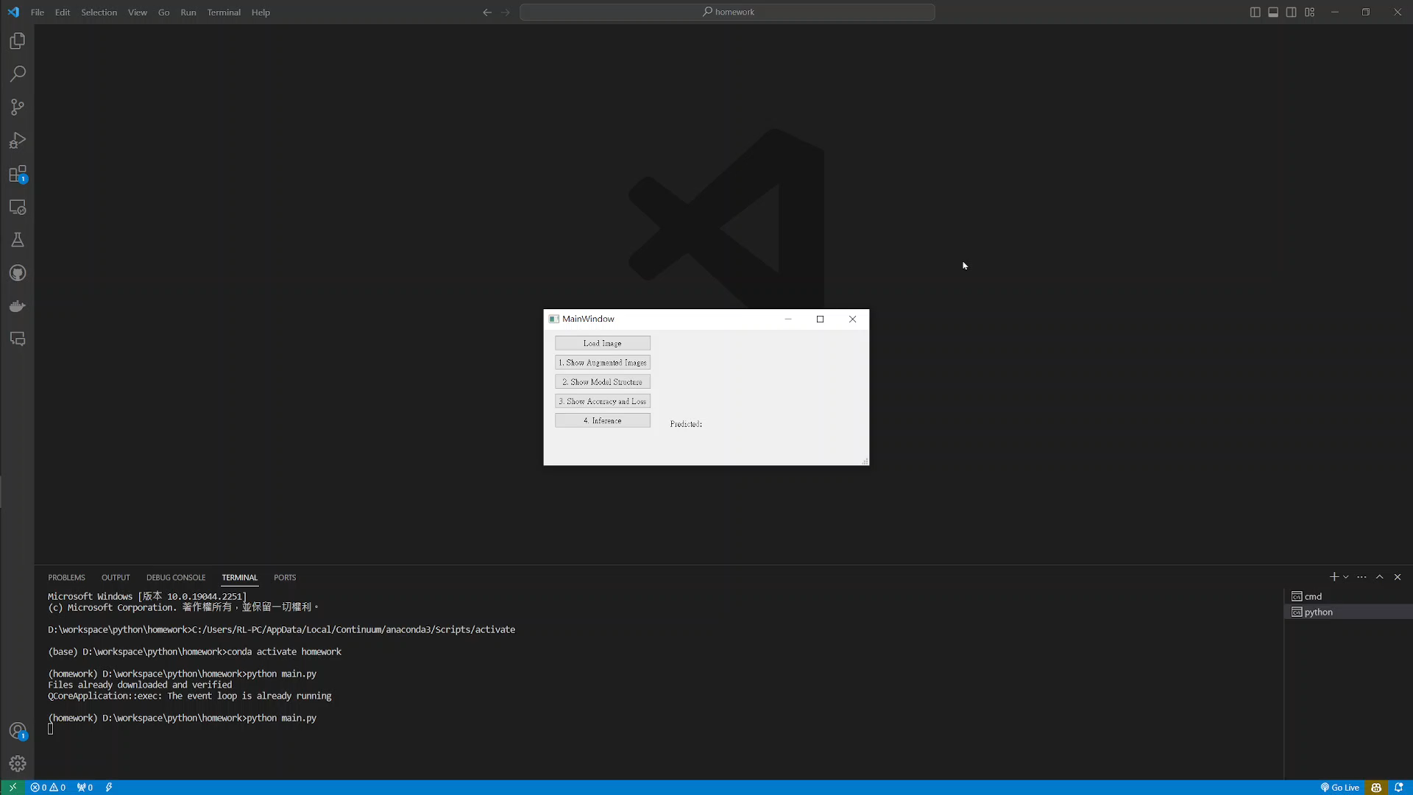
5. Training a CIFAR10 Classifier Using VGG19 – Example Video
(出題：Hsiang)
This is an example illustrating the objectives from 5.1 ~ 5.4.

